Slide 1
Using WordPress to Contextualize and Publish Digital Repository Content
Sarah Sweeney
Digital Repository Manager
Northeastern University Libraries, Digital Scholarship Group
Boston, Massachusetts

Slide 2
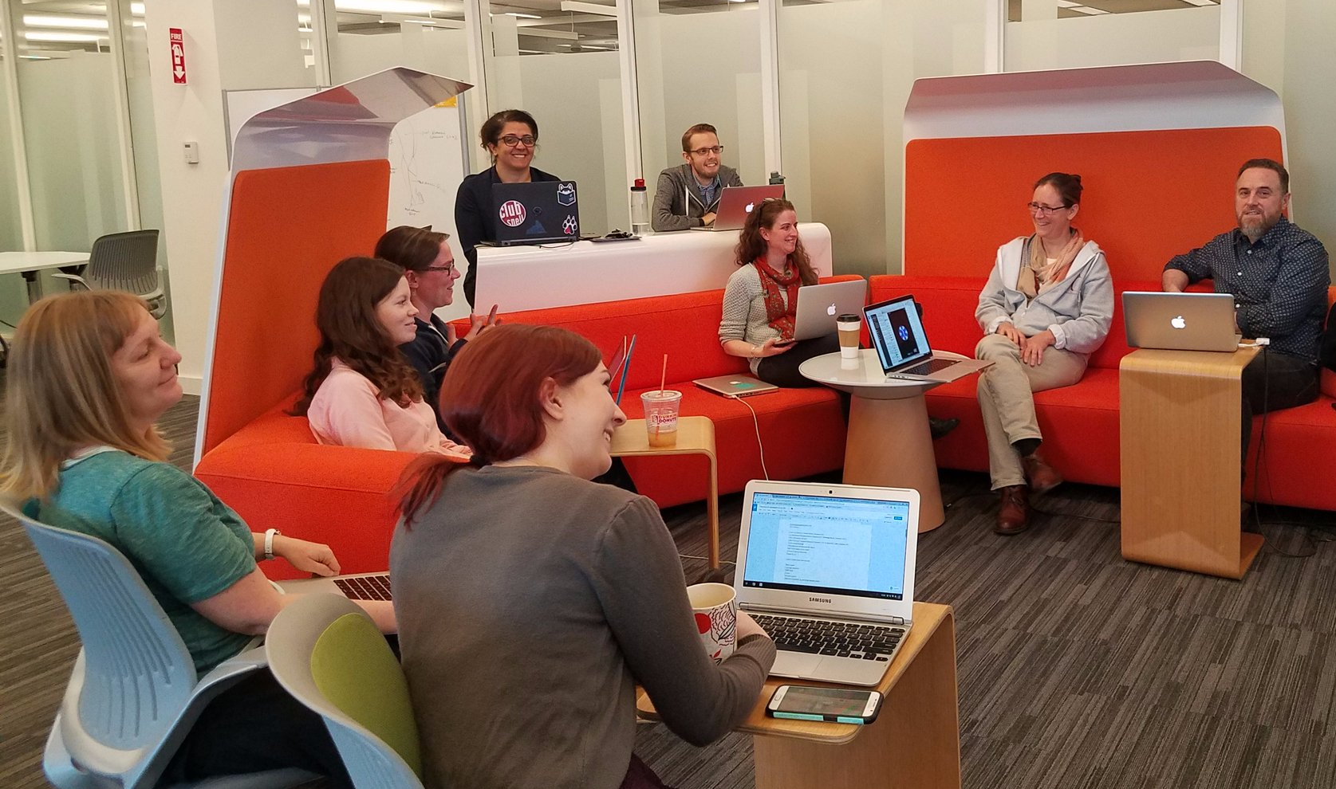
Who We Are
Northeastern University Libraries, Digital Scholarship Group
Text analysis and encoding
GIS
Data visualization
Data management
Repository services
Copyright guidance
Semantic web services

Slide 3
Problem Space
How can we represent the longevity and sustainability of digital humanities (DH) research projects as a shared responsibility?
How can we create a culture of partnership, in which the challenges are understood as shared research challenges?
Notes:
How can we represent the longevity and sustainability of digital humanities research projects as a shared responsibility that begins with fundamental project design decisions and data creation strategies, rather than purely an obligation of the library?
And how can we create a culture of partnership among faculty and student researchers and library staff, in which the challenges of digital curation are understood as shared research challenges rather than functional details of purely “technical” implementation?

Slide 4
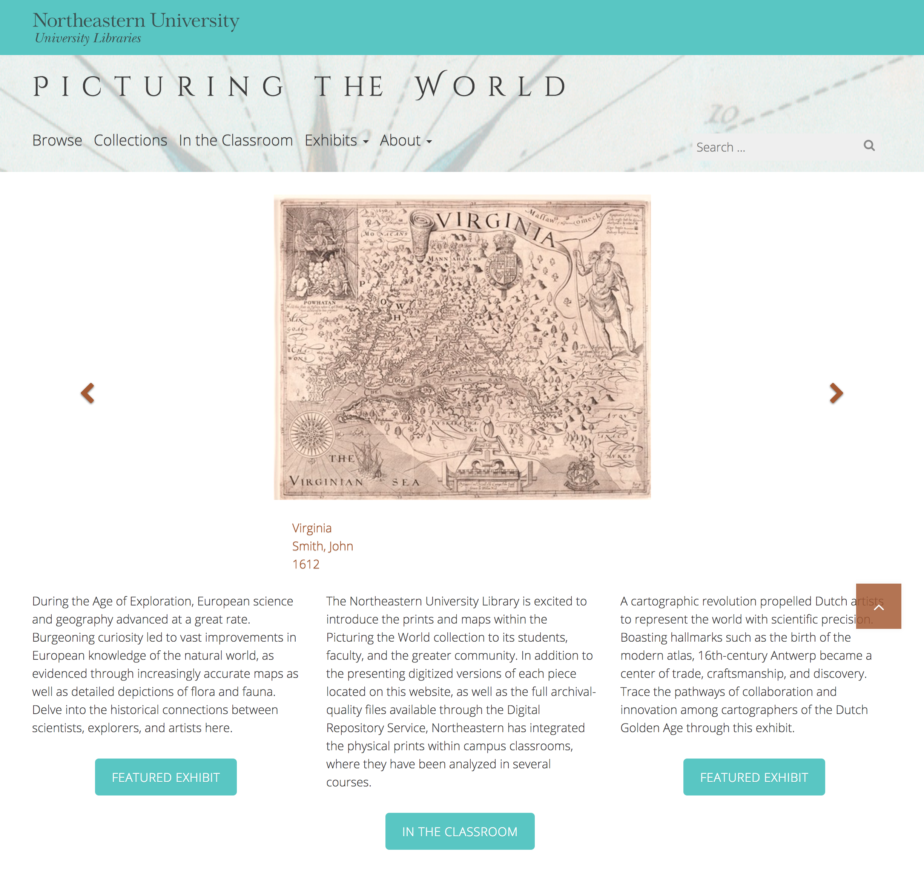
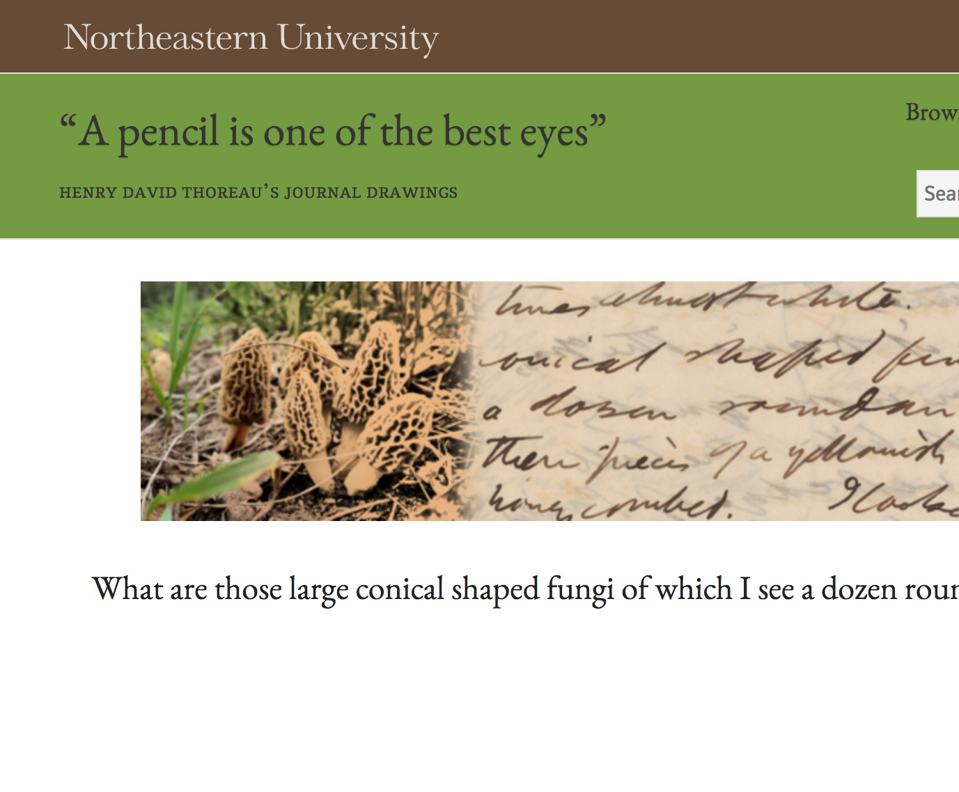
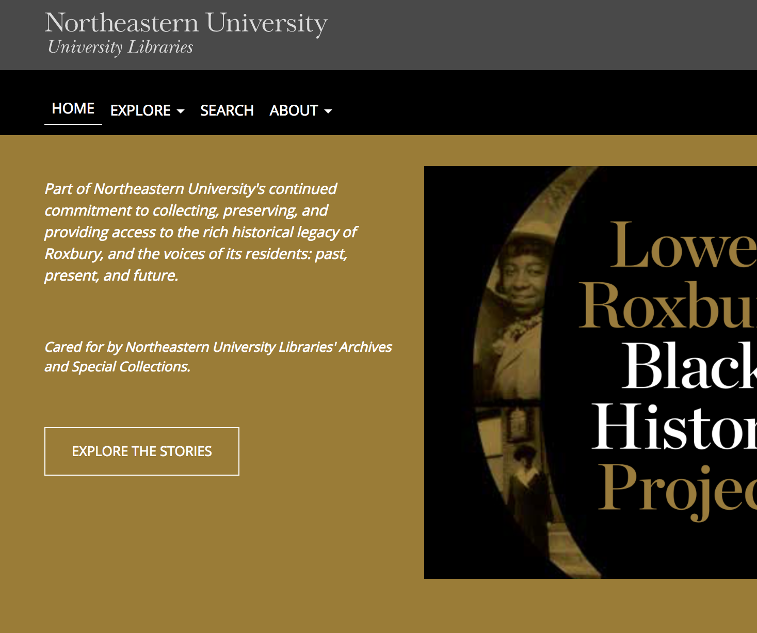
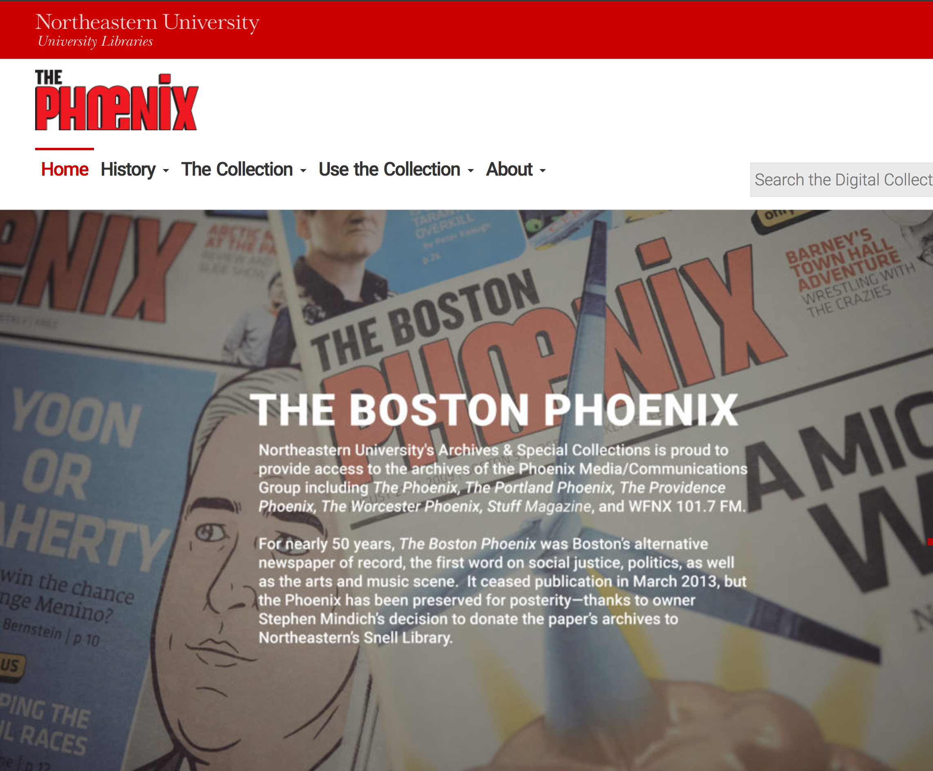
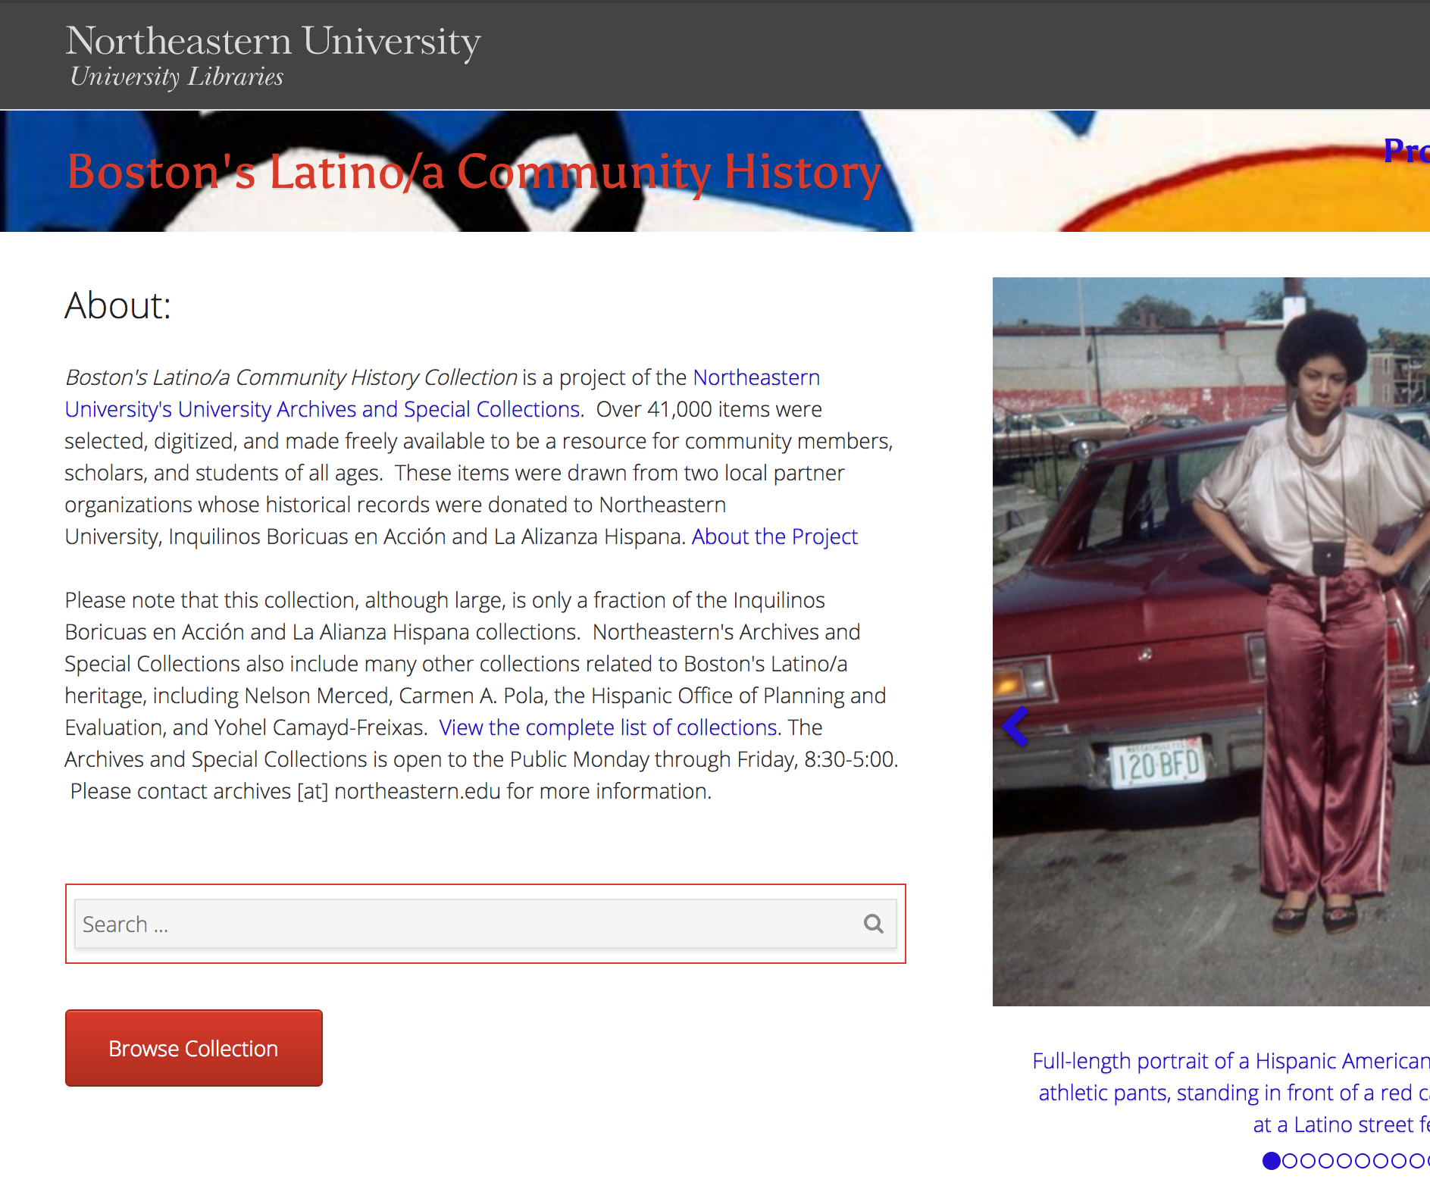
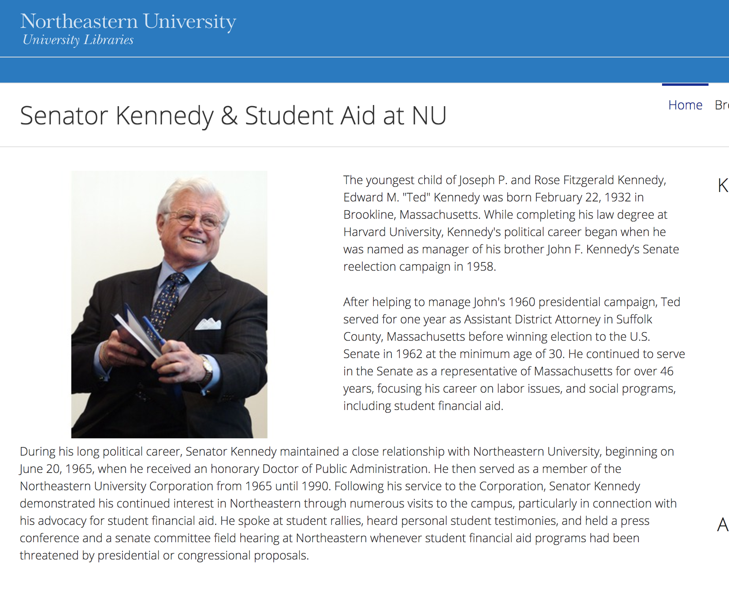
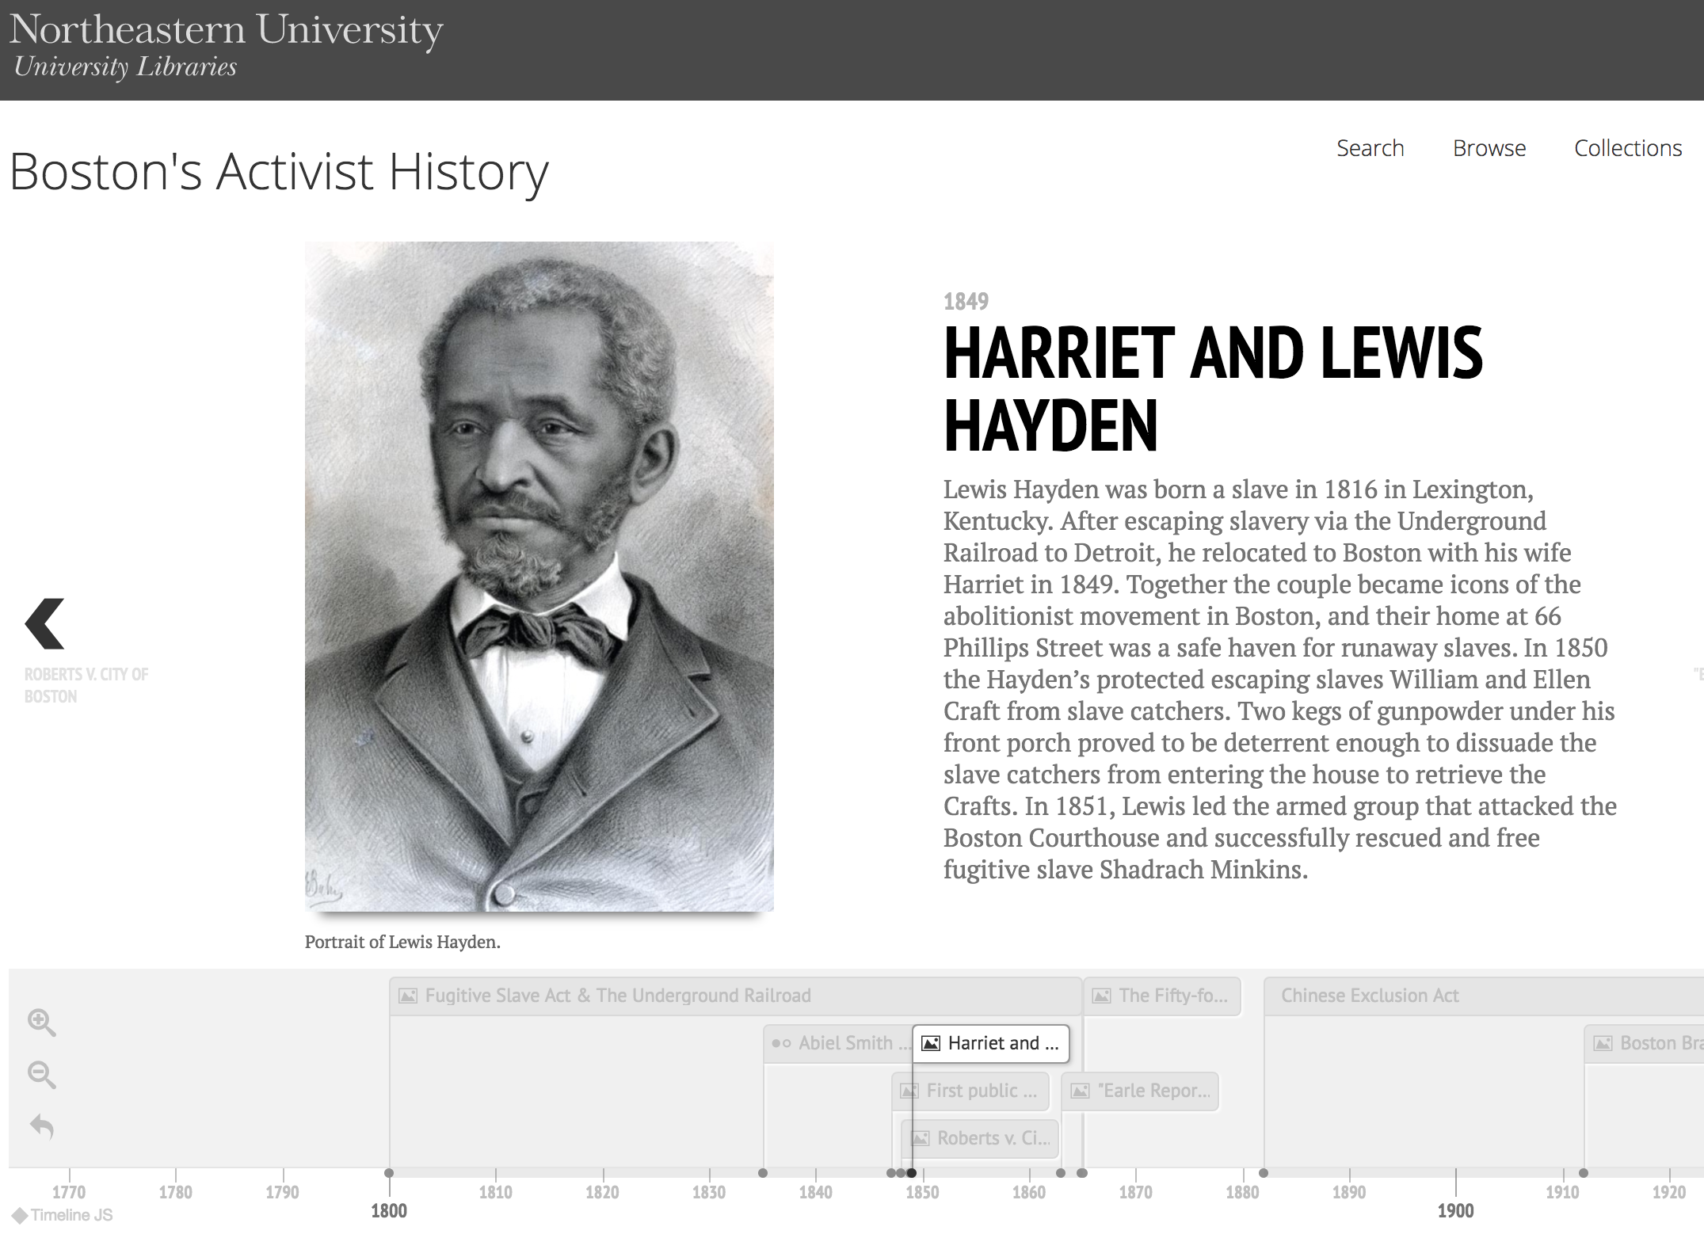
The Community Enhanced Repository
for Engaged Scholarship
(CERES)

Slide 5
Collaborative Development Principles
Support systems, not individual projects.
Materials should be curatable and usable.
Development is a shared research undertaking.

Slide 6
Custom Project WordPress Site
Custom Project WordPress Site
Custom Project WordPress Site
CERES WordPress Plugin
Data Source
Data Source

Slide 7

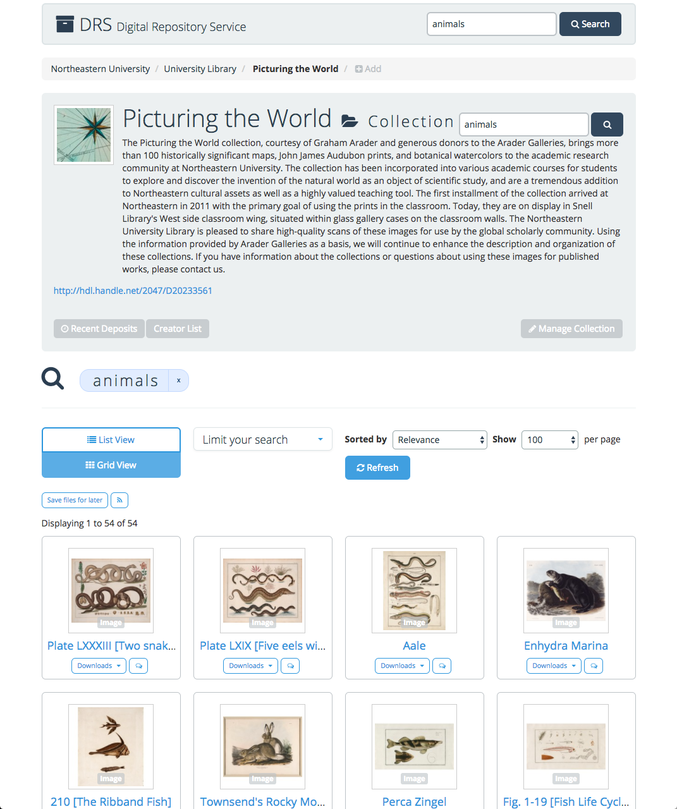
Data Sources
Digital Repository Service
(DRS)
repository.library.northeastern.edu
Notes:
/Users/sarahjeansweeney/Desktop/2017-06-05_1620.png

Slide 8
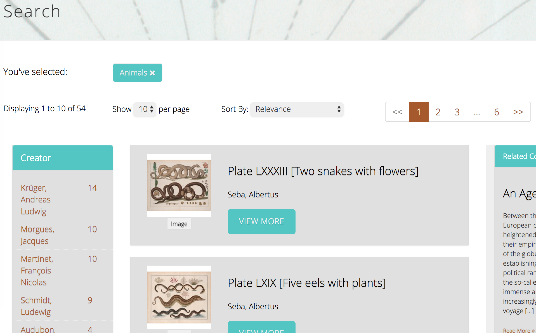
Data Sources
Digital Repository Service
(DRS)
repository.library.northeastern.edu

Slide 9
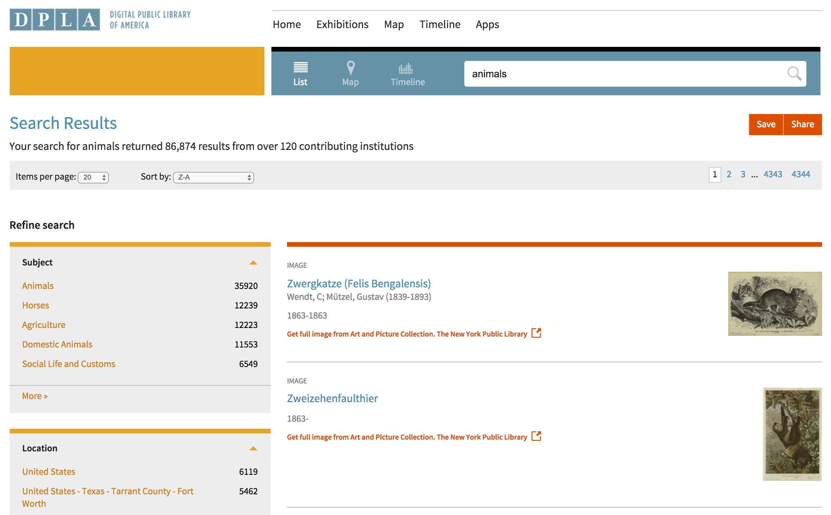
Data Sources
Digital Public Library of America (DPLA)
dp.la

Slide 10
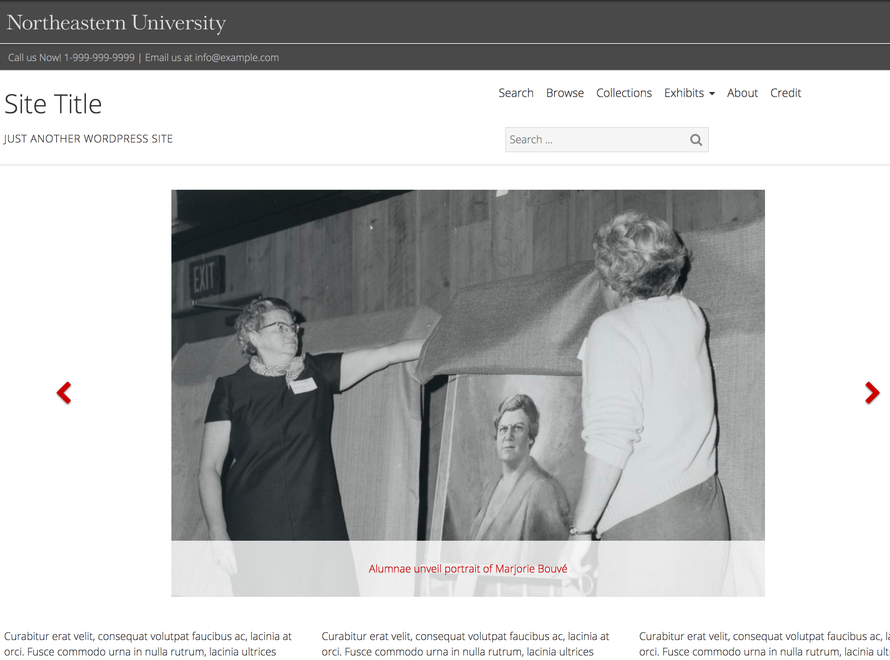
Framework

Slide 11
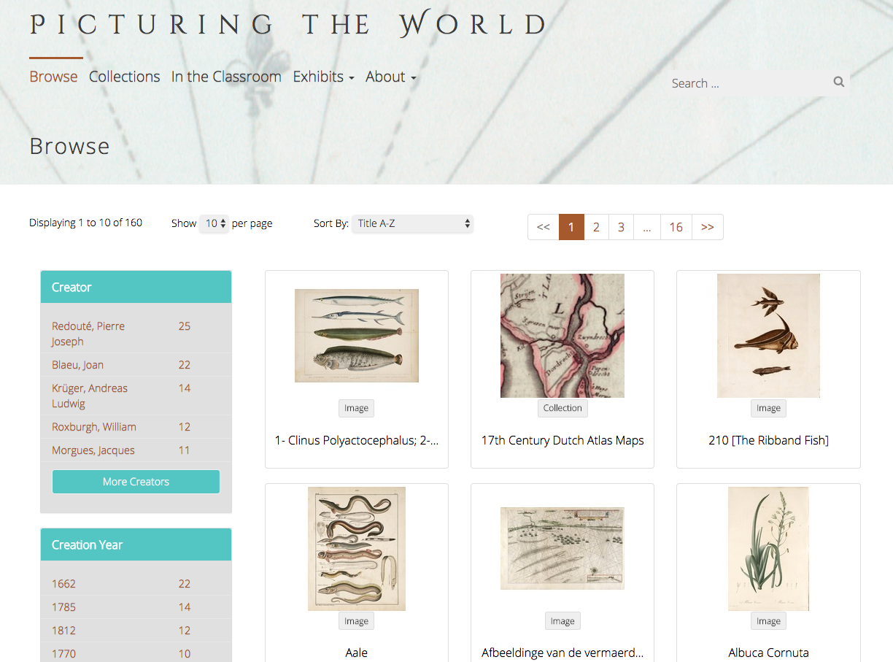
File Browse

Slide 12
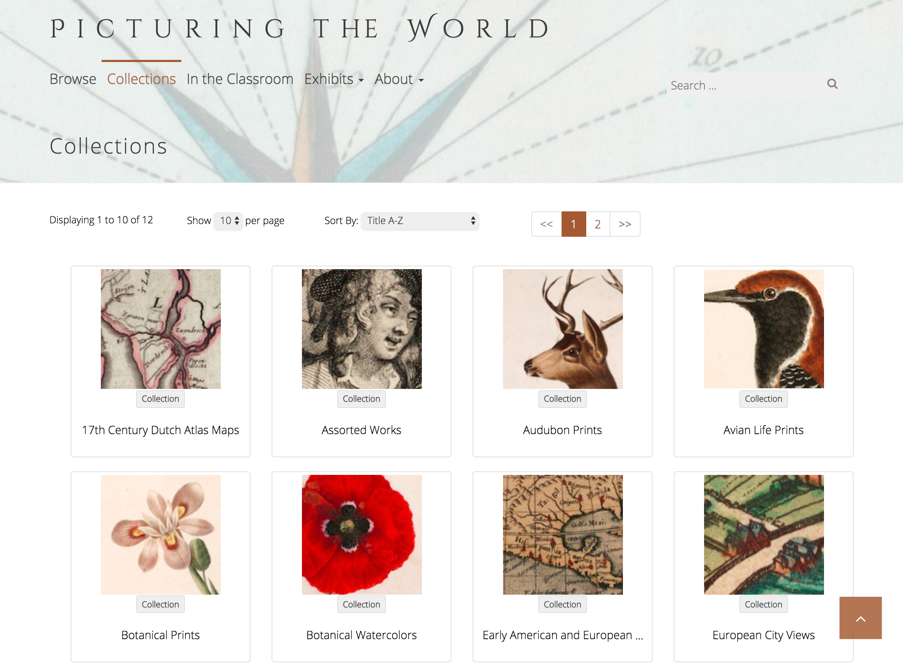
Collection Browse

Slide 13
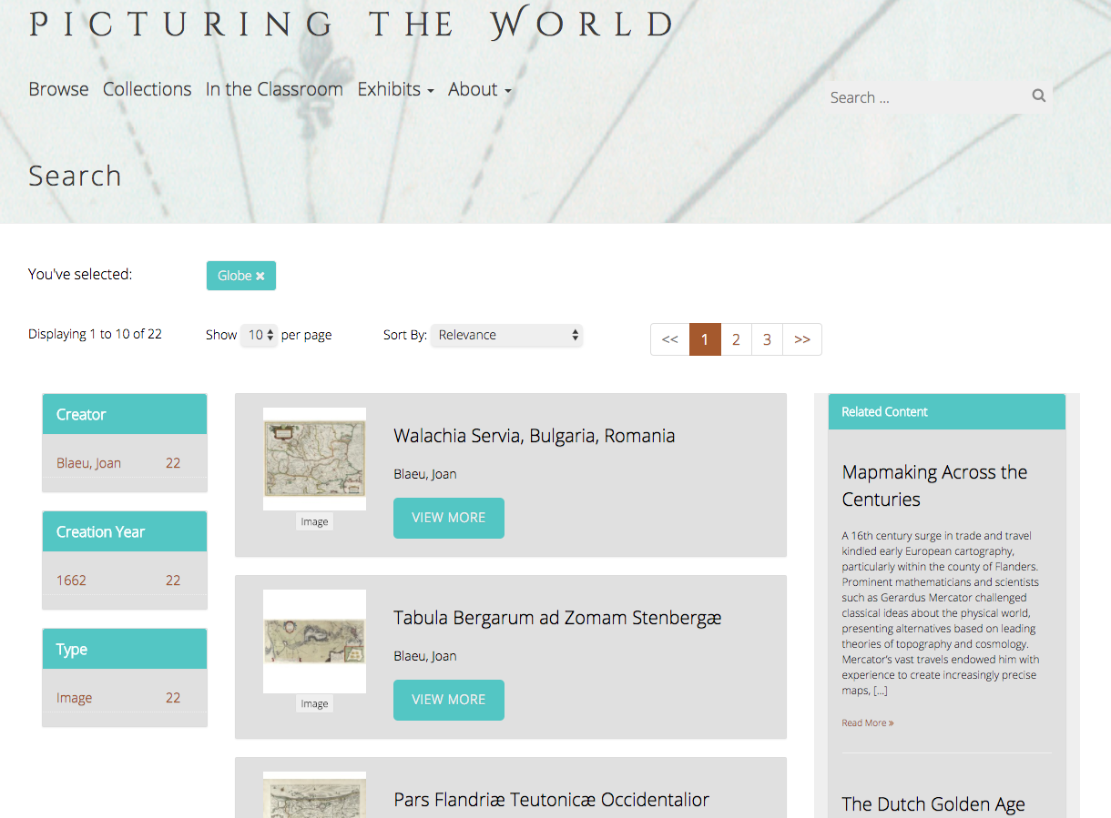
Search

Slide 14
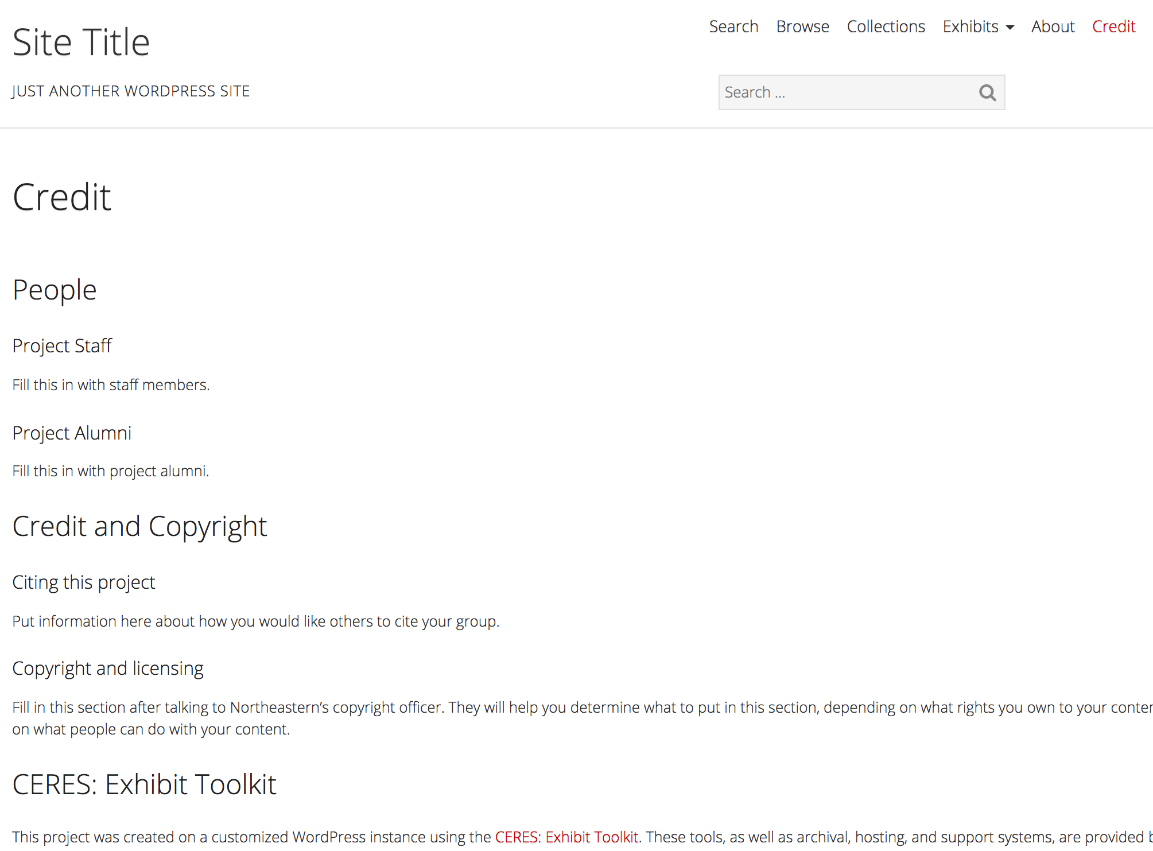
Framework

Slide 15
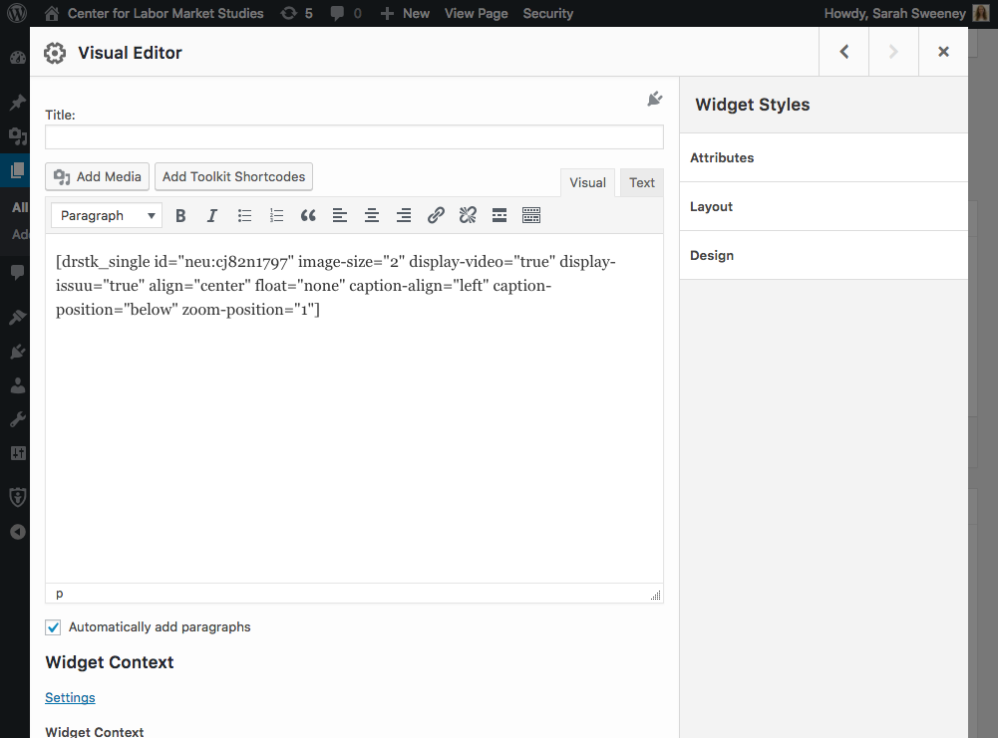
Exhibit Tools

Slide 16
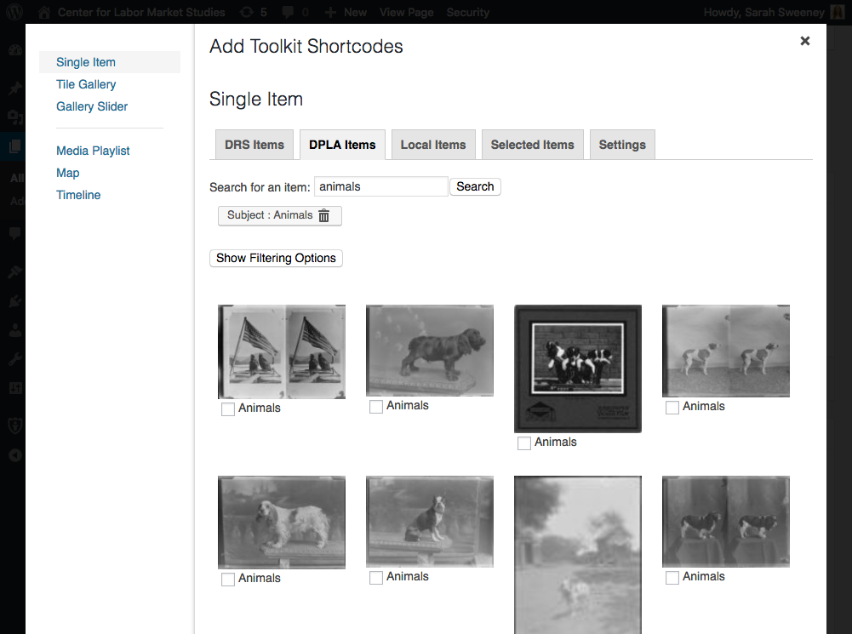
Exhibit Tools

Slide 17
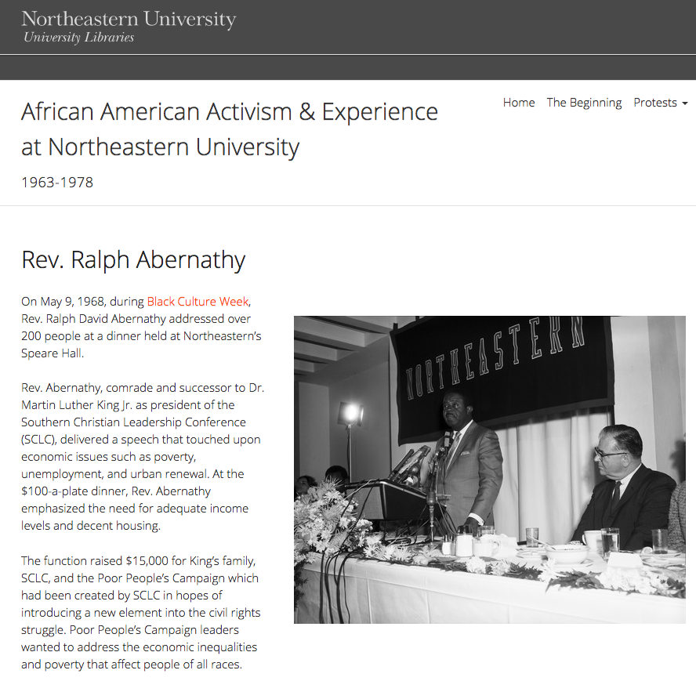
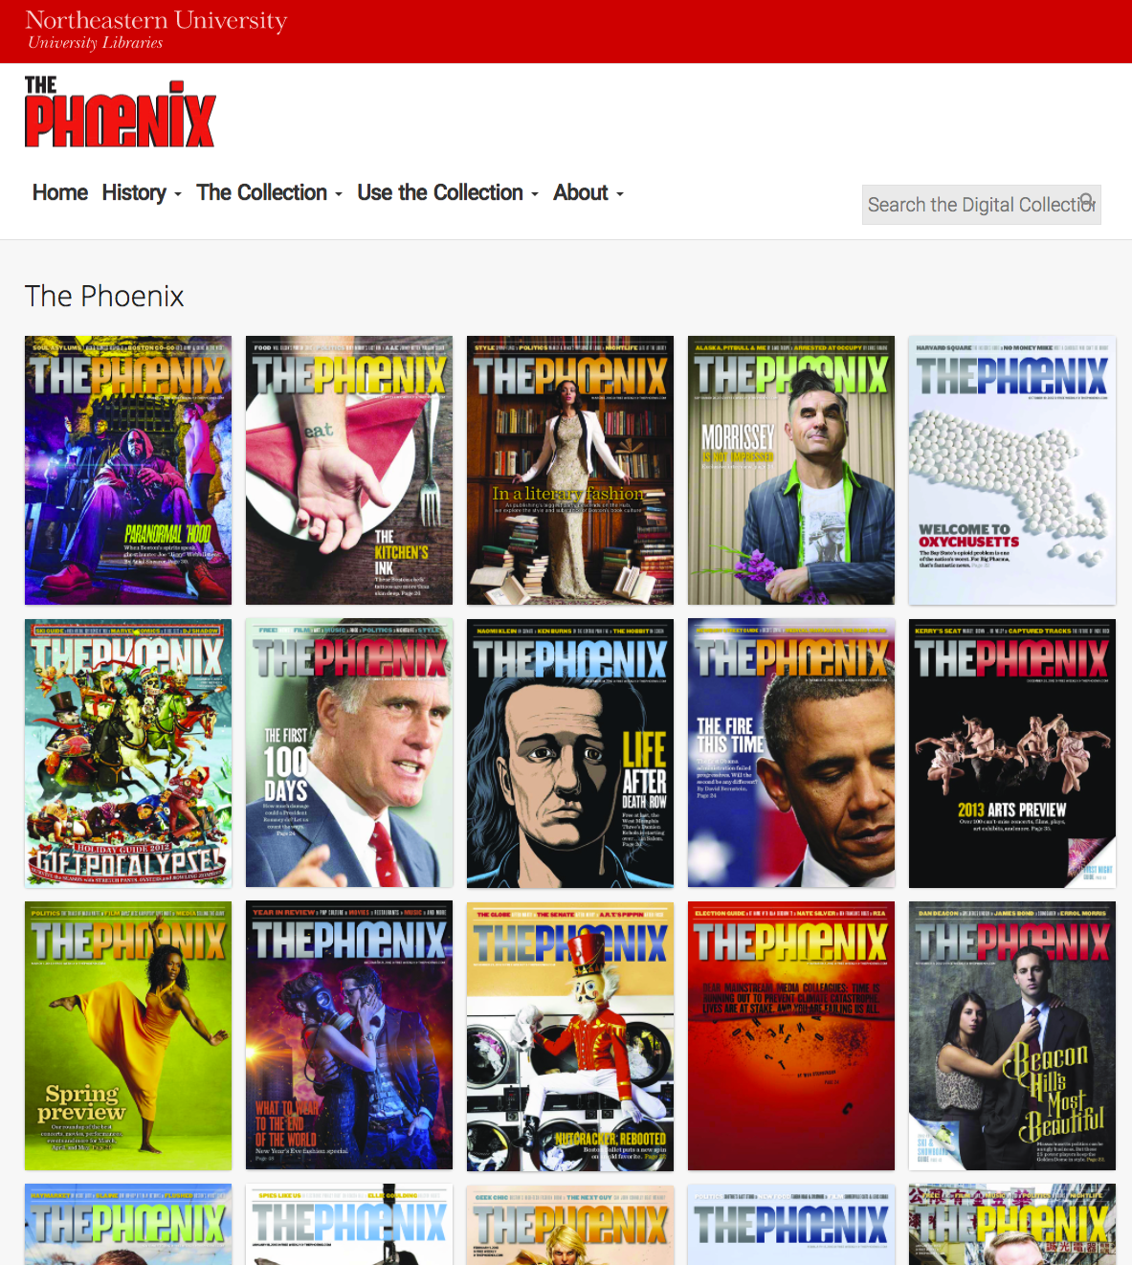
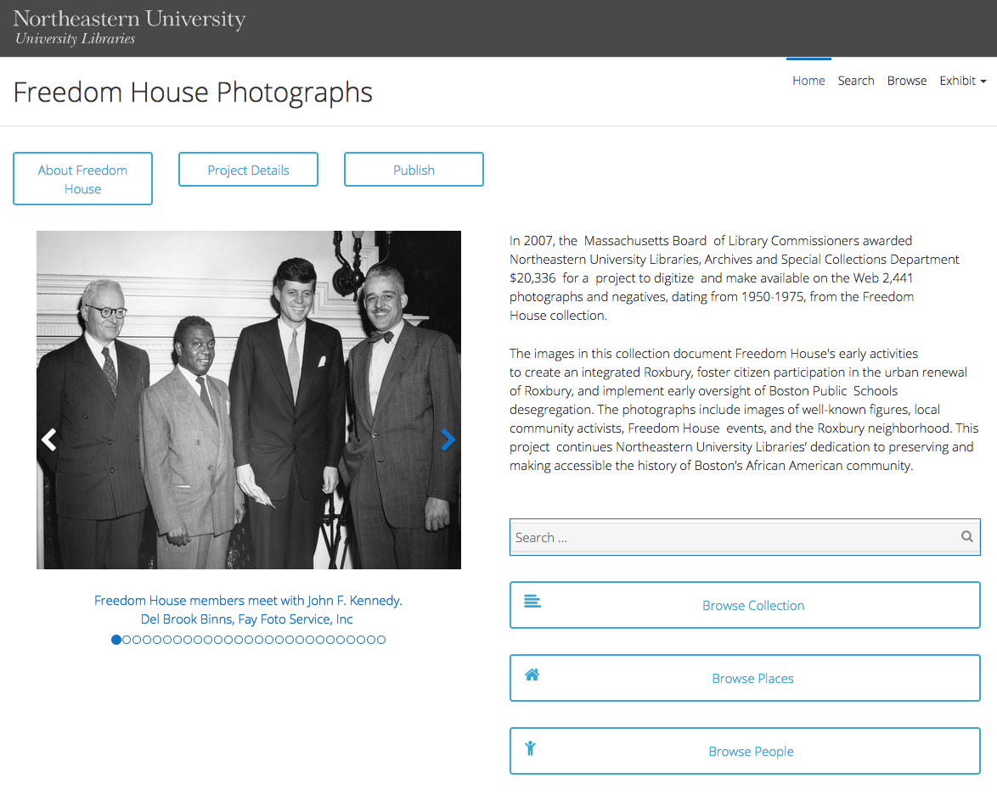
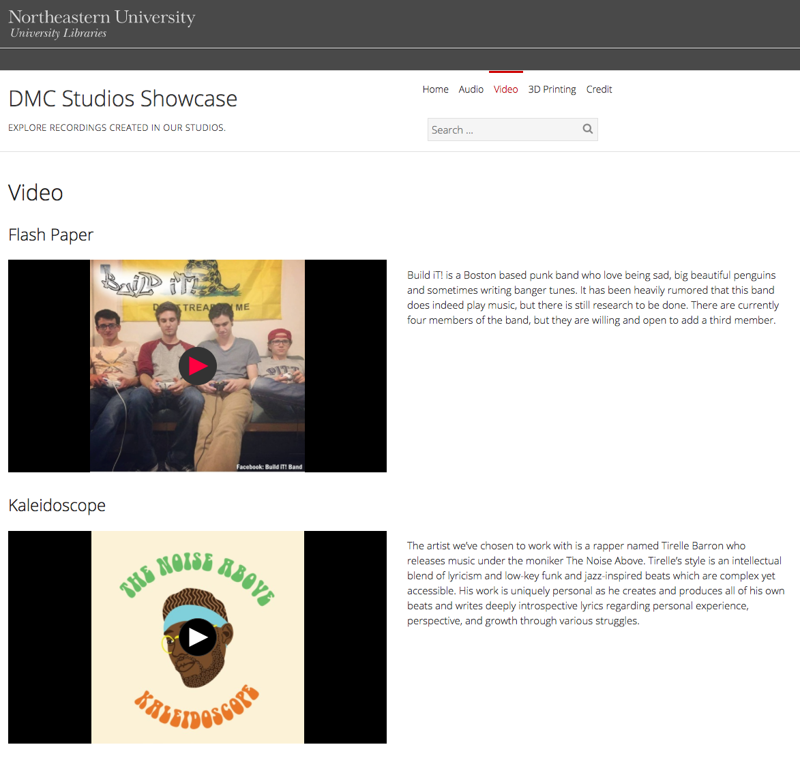
Exhibits

Slide 18
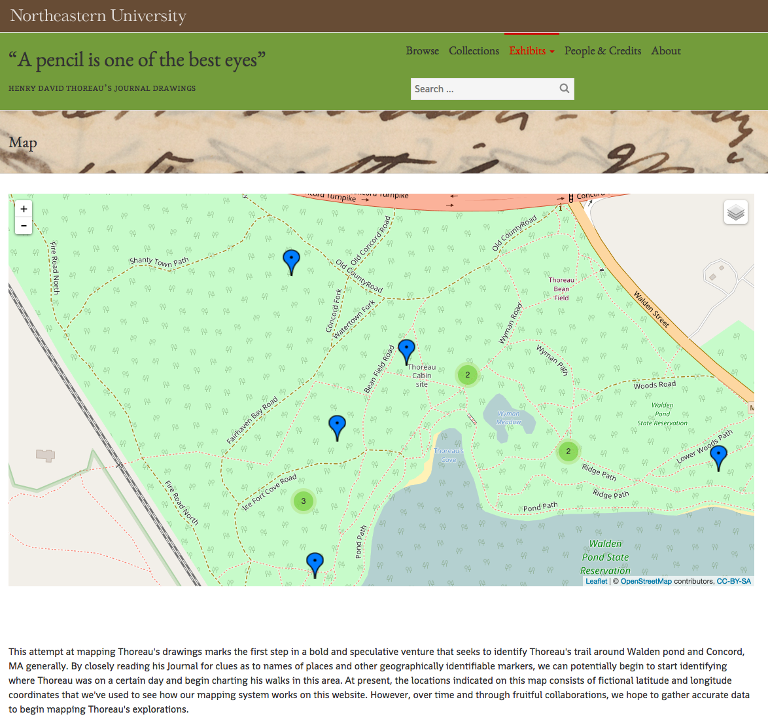
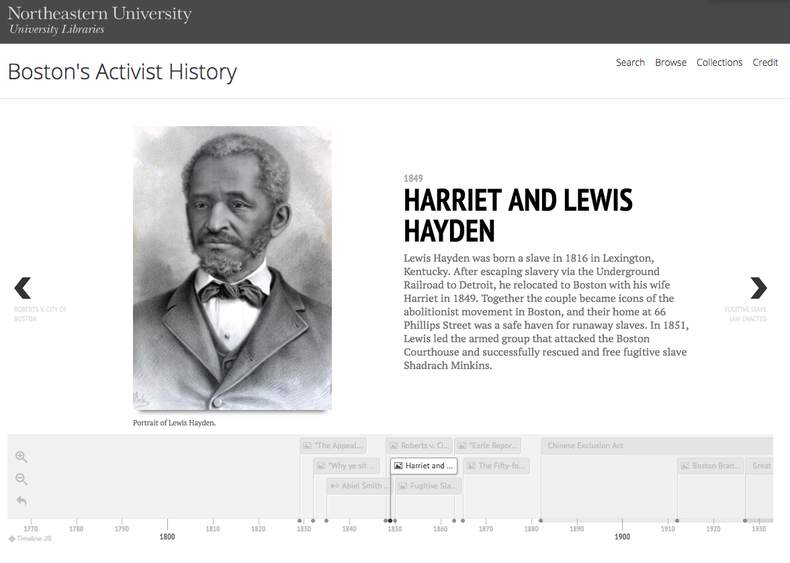
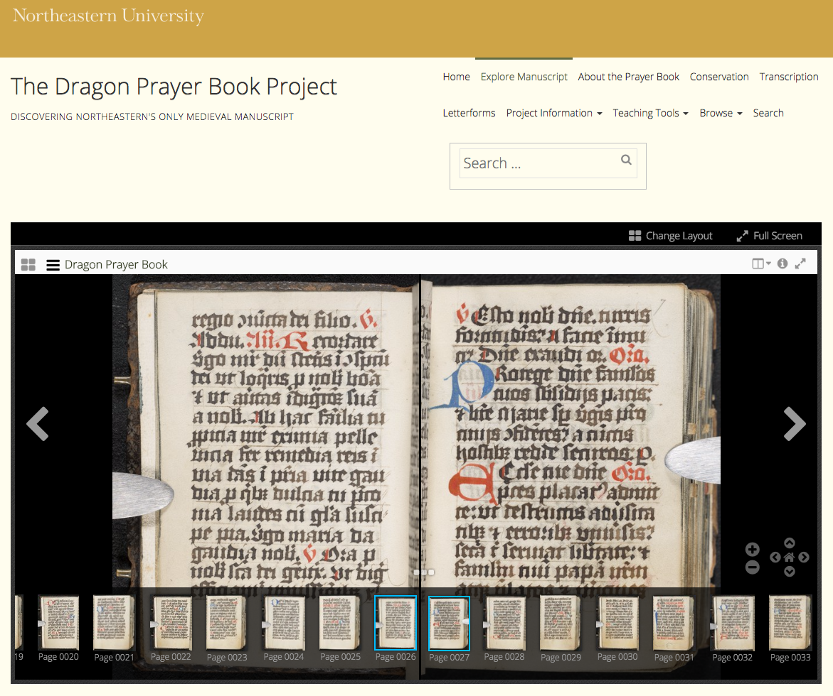
Exhibits

Slide 19
Workflow
Annual Check-in
All DSG Projects Must:
Submit a project proposal
Participate in an intake interview
Write a data management plan
Participate in an annual check-in meeting
Data Management Plan
Intake Interview
Project Proposal

Slide 20
CERES Projects
goo.gl/D502a3

Slide 21
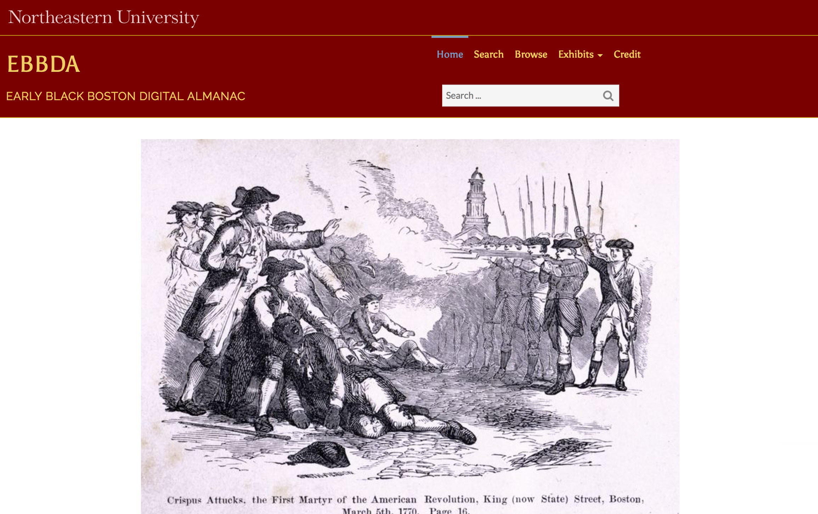
Early Black Boston
Digital Almanac
(not yet public)

Slide 22
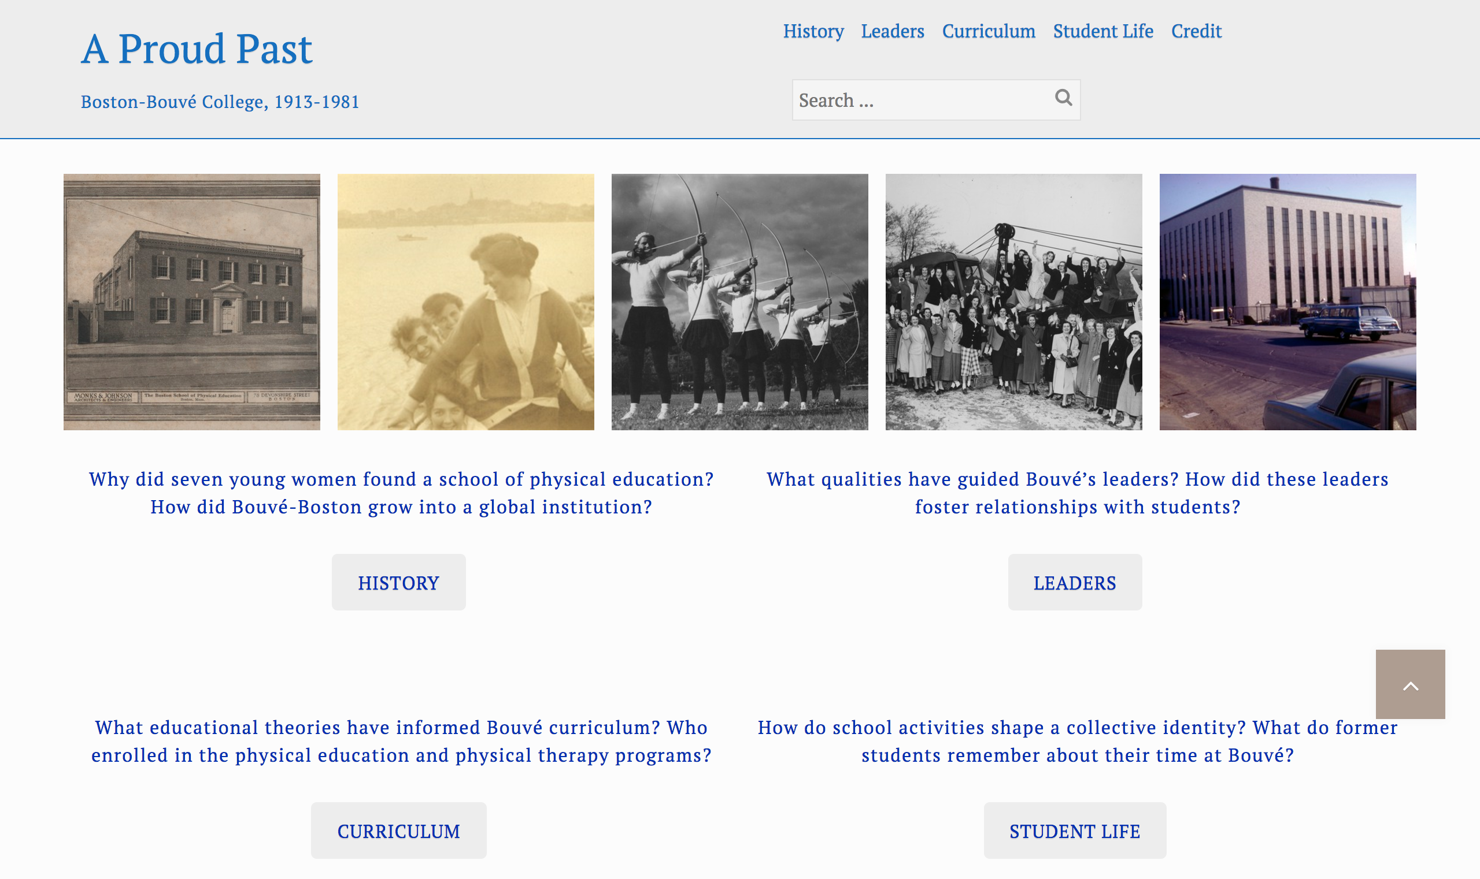
A Proud Past: Boston-Bouvé College, 1913-1981
http://aproudpast.library.northeastern.edu/

Slide 23
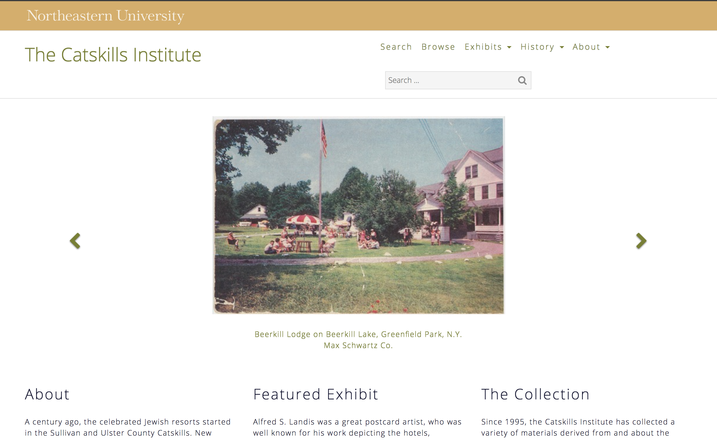
The Catskills Institute
http://catskillsinstitute.northeastern.edu/

Slide 24
Collaborative Development Principles
Support systems, not individual projects. ✓
Materials should be curatable and usable. ✓
Development is a shared research undertaking. ✓

Slide 25
goo.gl/D502a3

Slide 26
Questions?
Resources
About CERES
http://dsg.neu.edu/ceres/
Digital Repository Service
https://repository.library.northeastern.edu/
CERES Sites
goo.gl/D502a3
Contact
Sarah Sweeney
Digital Scholarship Group
Northeastern University Libraries
sj.sweeney@northeastern.edu
@akaSarahJean

